Slide 1

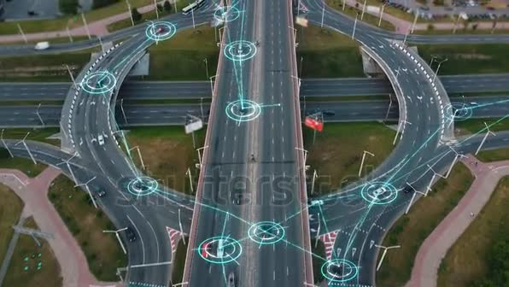



Vehicle Detection
Using Deep Learning (YOLOv8)
Prepared by: Sahab AL-Amri

Slide 2




Problem Statement
Traffic monitoring requires accurate vehicle detection
Manual monitoring is slow and inefficient
Traditional systems struggle with real-time detection
Need for an AI-based automated solution

Slide 3

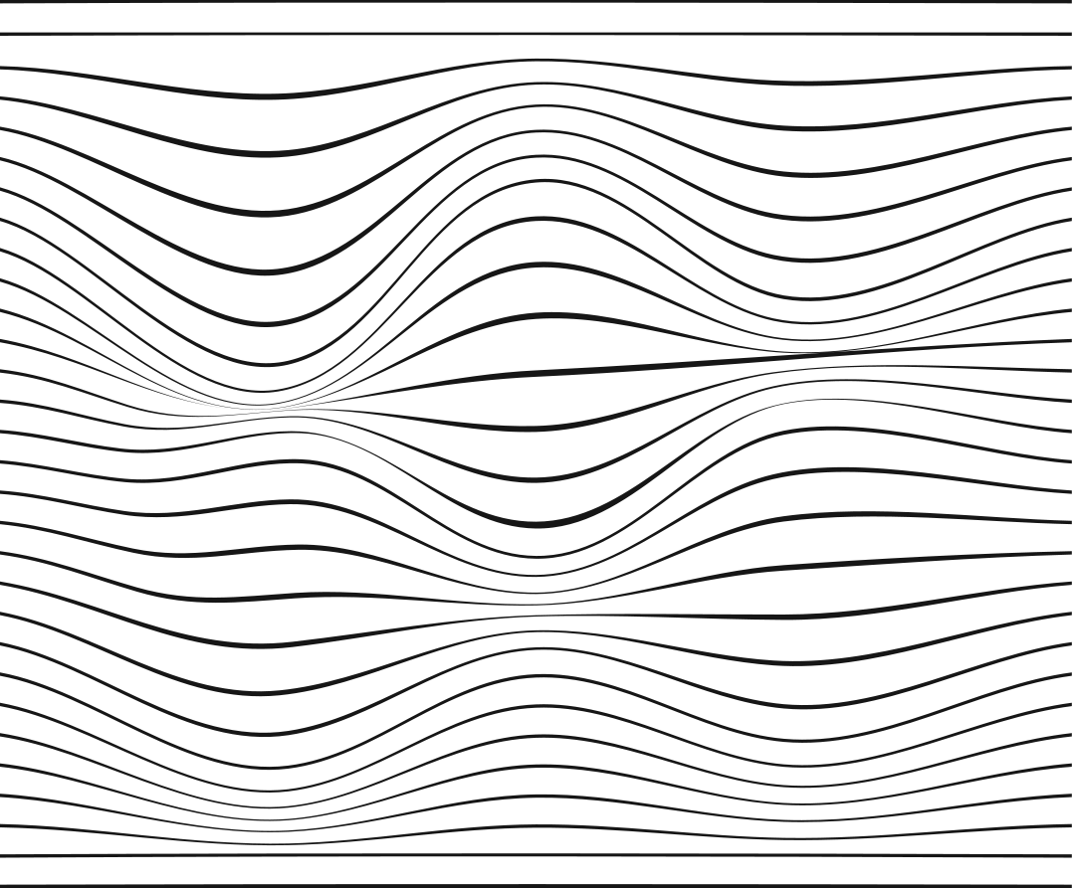
Project Objective
1
3
Build a deep learning model for vehicle detection
Detect multiple vehicle types
2
4
Use YOLO (You Only Look Once) object detection
Develop an AI-based software application

Slide 4




Dataset
Dataset source: Kaggle – Vehicle Detection Dataset
Contains annotated images of vehicles
Multiple classes (car, bus, truck, motorcycle, etc.)
Bounding box annotations (YOLO format)
Suitable for object detection tasks

Slide 5
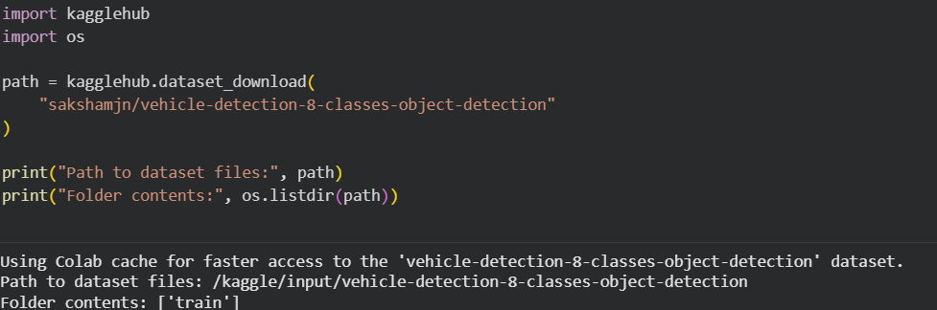
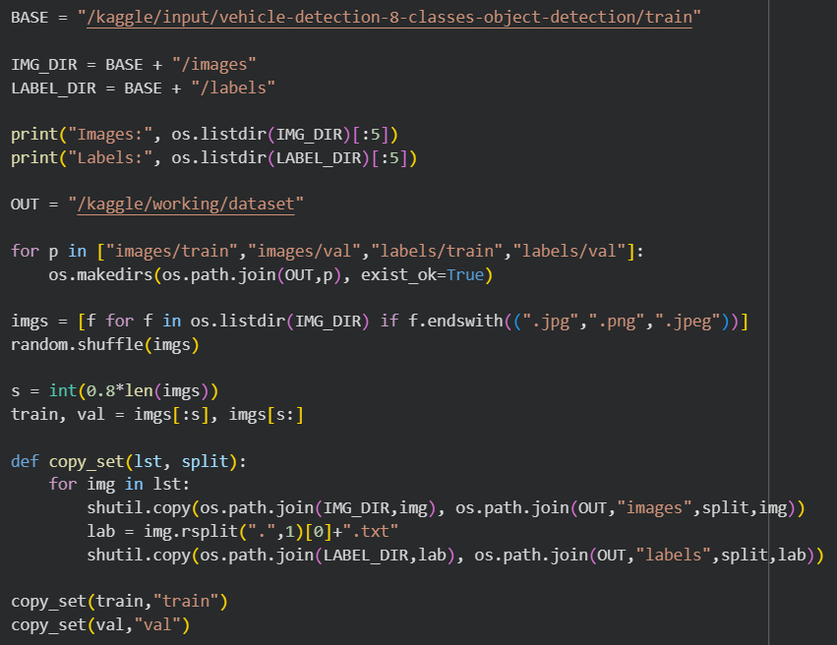
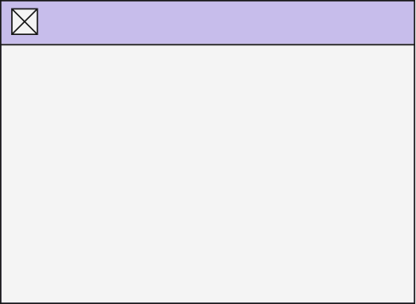
Data Preparation
1
2
Downloaded dataset from Kaggle
Organized data into train / validation / test
Verified image and label consistency
Created train / validation split (80/20)
Organized dataset for YOLO format
Ensured no missing labels
Images: ['Highway_143_2020-07-30_jpg.rf.a7076f71b722e151bc3533a818aea182.jpg', 'ulu554_jpg.rf.2e267781b53958af49b1e9ab5f264d9a.jpg', 'Highway_977_2020-07-30_jpg.rf.36614aa85bf97bac966b4097e475b4a9.jpg', 'ulu2353_jpg.rf.4343ef0396842f66112639b7604eb643.jpg', 'Highway_1126_2020-07-30_jpg.rf.d464fc6d9a53e62a2b6b01ade432c627.jpg']
Labels: ['ulu1386_jpg.rf.a5750e969785c5d69b5980d51e7f0b6b.txt', 'Highway_830_2020-07-30_jpg.rf.bdd5acbefb212b679668e9862841710c.txt', 'ulu1470_jpg.rf.2330f337e0bb2584c3429ed90c63ab1a.txt', 'ulu2190_jpg.rf.2182d0a98b9101a7a587570f9b4ab98c.txt', 'Highway_69_2020-07-30_jpg.rf.49b04efa04d91ffbcf6969510a0b3088.txt']

Slide 6
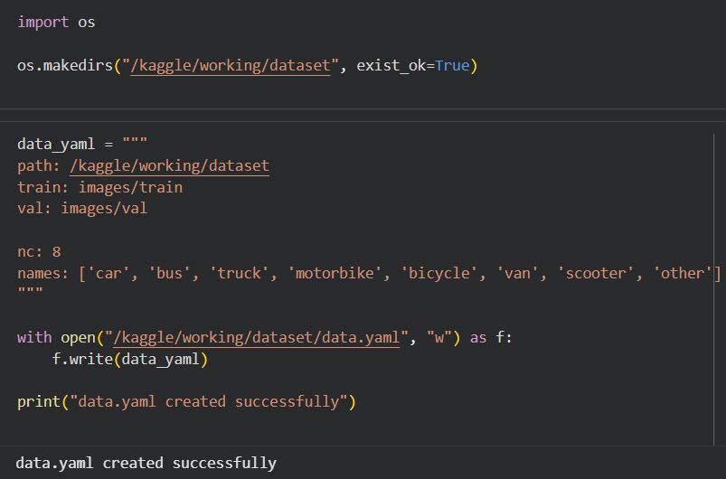
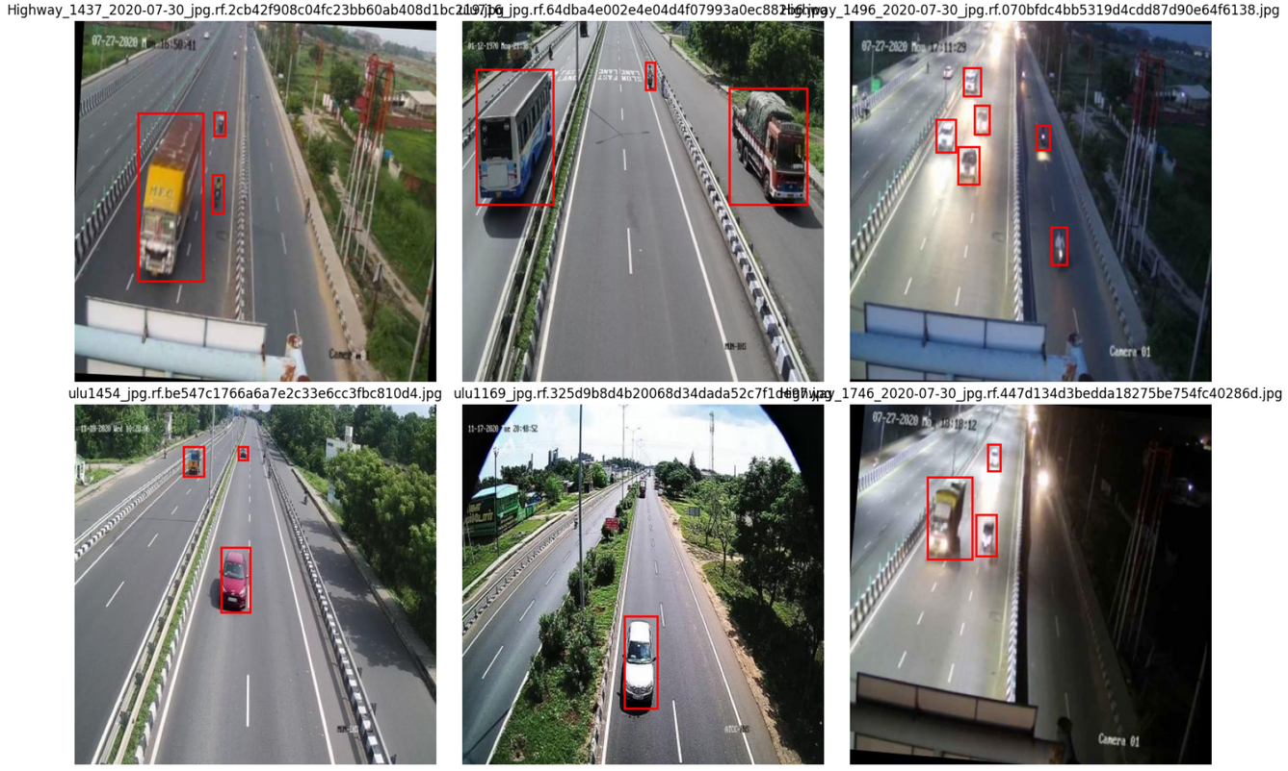
Data Preparation
3
4
Created data.yaml file
Verified Image–Label Matching

Slide 7
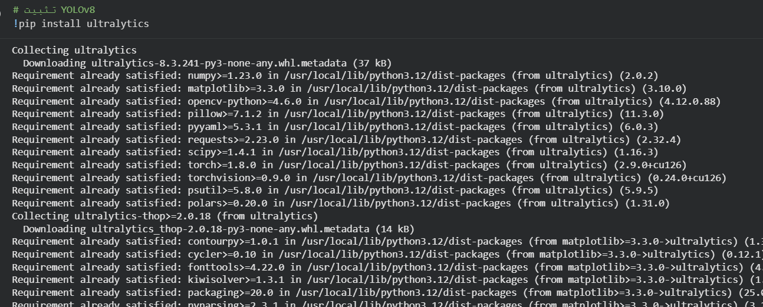
Deep Learning Model (YOLO)
YOLO (You Only Look Once) is a real-time object detection algorithm.
It detects objects and their bounding boxes in a single pass.
Fast and accurate compared to traditional methods.

Slide 8
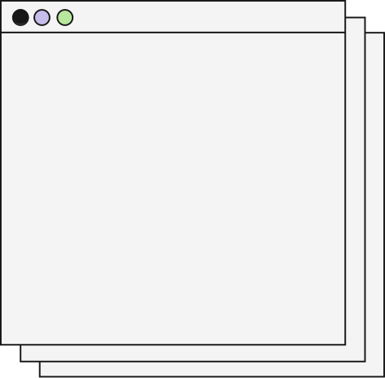
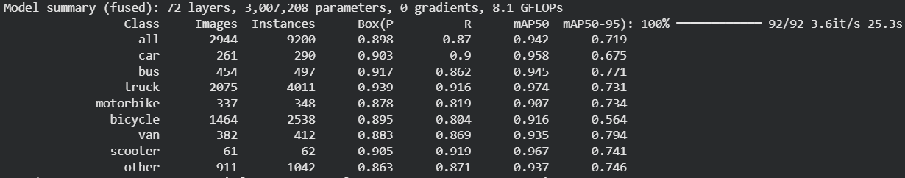
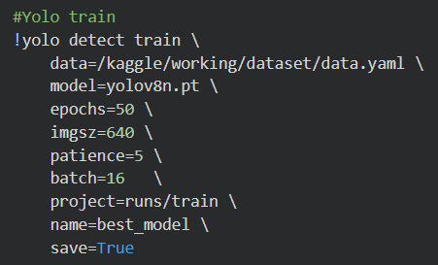
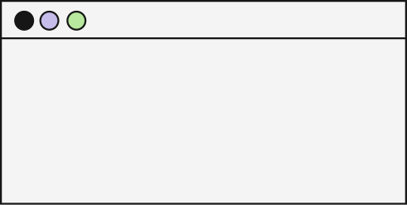
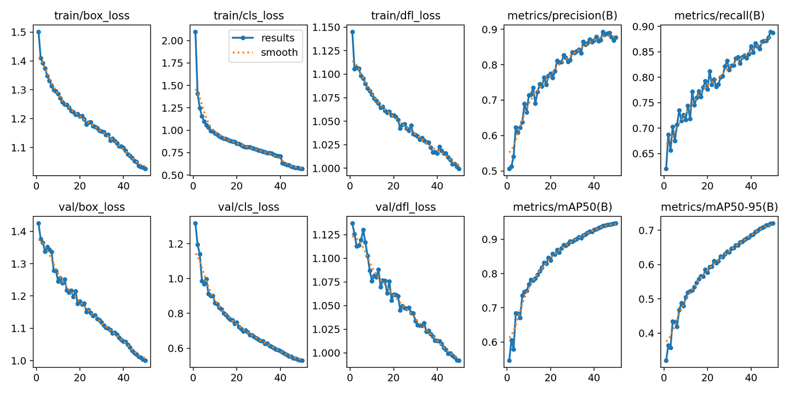
TRAINING CONFIGURATION
FINAL EVALUATION RESULTS
YOLO Training and Evaluation
Bullet Points:
mAP@50: 0.942
mAP@50–95: 0.719
Precision: 0.898
Recall: 0.870
TRAINING PERFORMANCE
Training and validation loss decreased over epochs
Model converged successfully
No significant overfitting observed

Slide 9
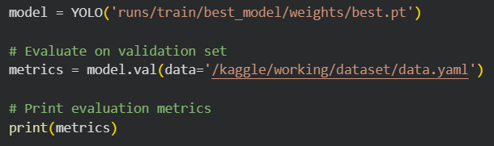
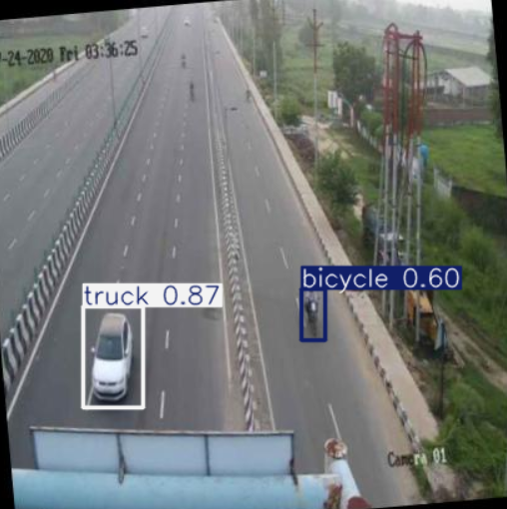
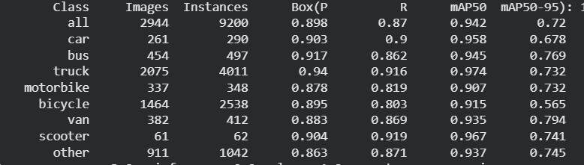
Model Evaluation
Model Evaluation on Unseen Data
Applied trained YOLO model on unseen validation image
Correctly detected multiple vehicle classes
High confidence scores achieved
Minimal false detections

Slide 10

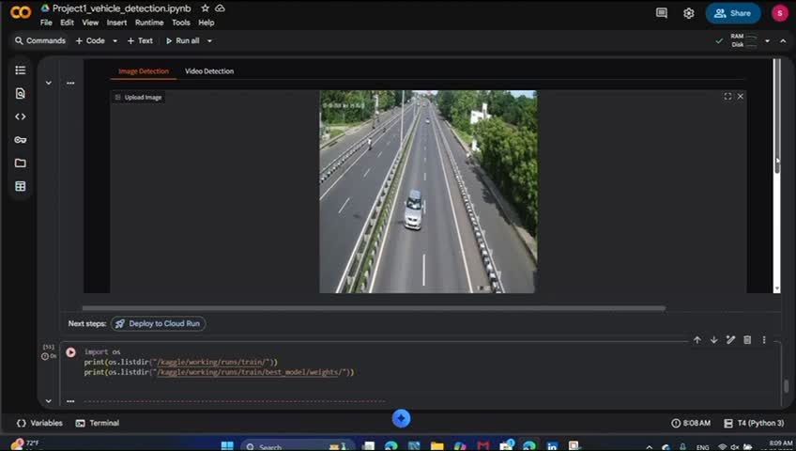
GUI Design & Integration
The system integrates AI with a simple interface to make vehicle detection user-friendly
Image Vehicle Detection

Slide 11
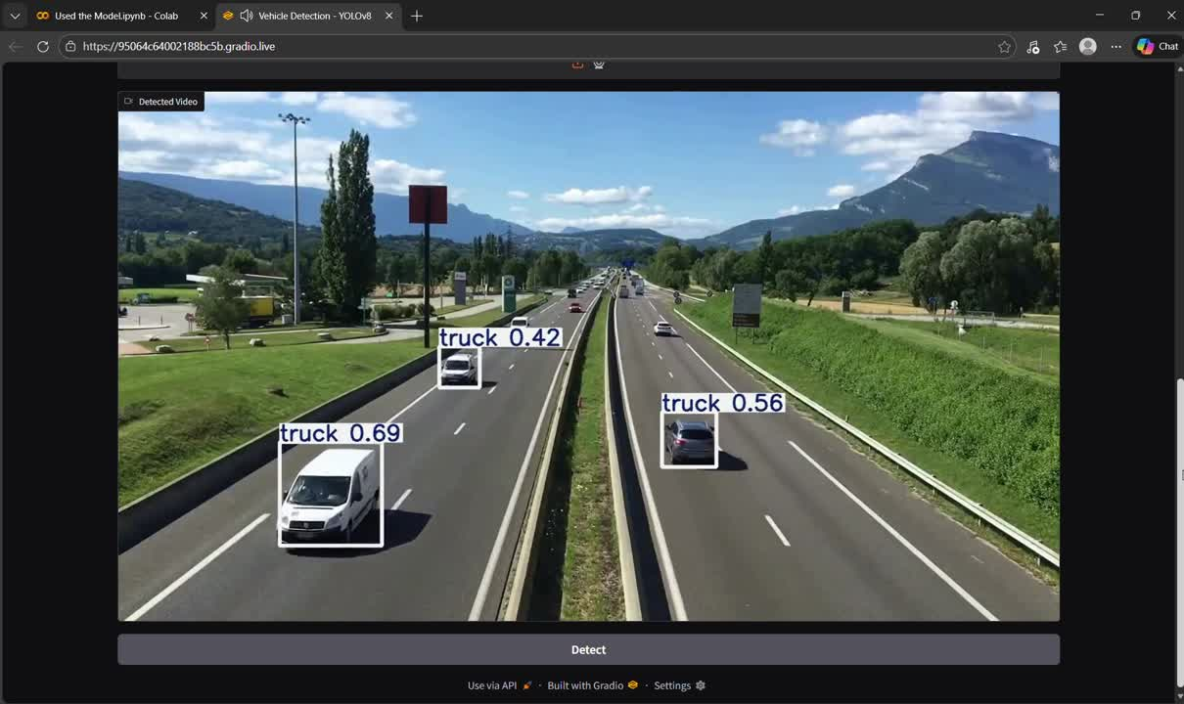
GUI Design & Integration
Video Vehicle Detection

Slide 12


